Slide 1


Inotebook
Prepared By:-
Name : Vedant Atul Simaria
Roll no : 169
Enrollment No : 21002170110185
Batch : A5 Branch : CE

Slide 2
Project Outline:-
This Project is about Storing Notes .
I have developed this by using MERN Stack .
In this User Have to First Signed up and after login they can use this app.

Slide 3
Advantages of My Project
Different Users Can Access this App And have their Notes and this notes are only visible to them and User Privacy is our key point.
In this project I have apply hashing and add salt in password so user data will be safe in case if someone try to hack my website.

Slide 4
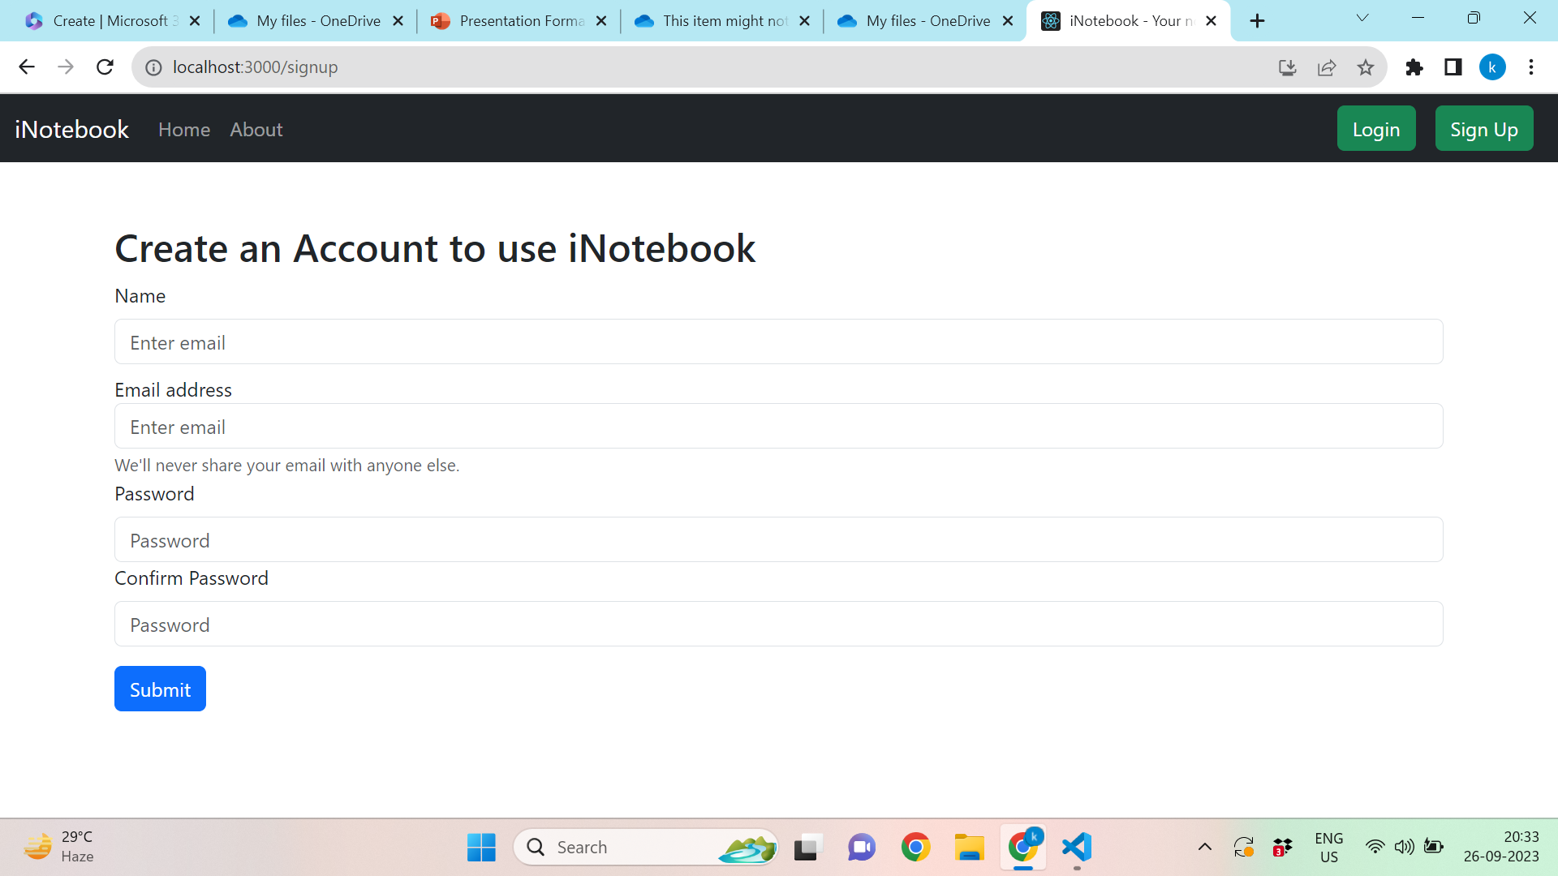
Sign Up

Slide 5
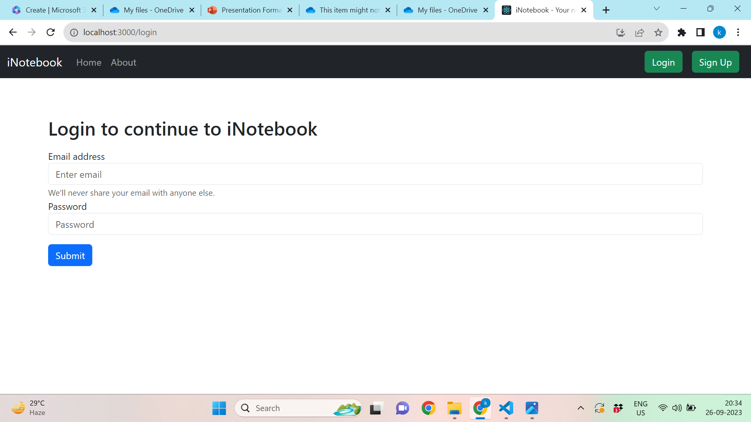
Login

Slide 6
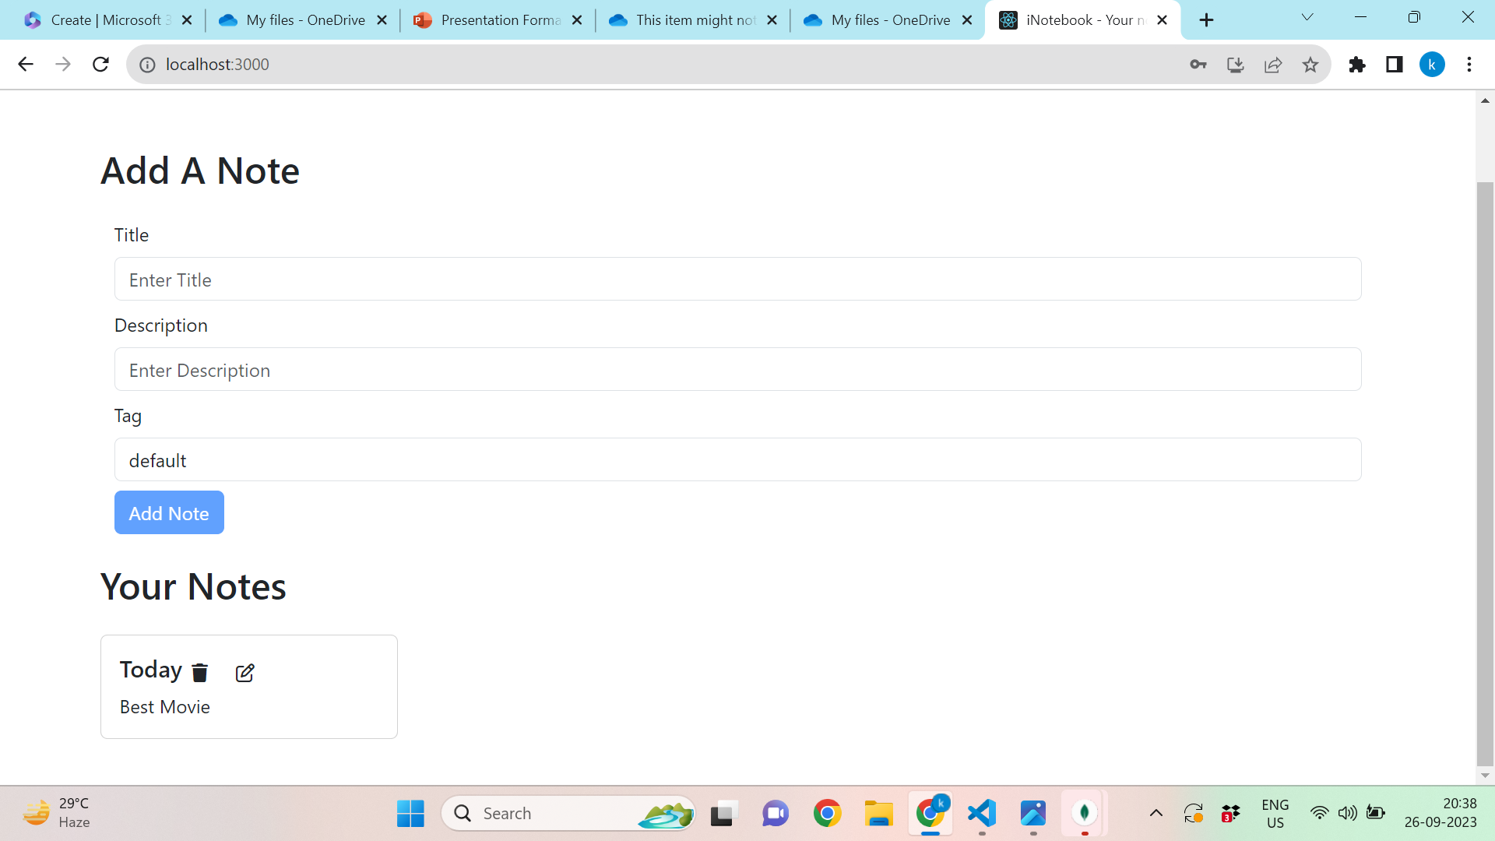
Home

Slide 7
THANK YOU….

